Slide 1

Farming Assistance Web Service
Presented by :
Y. Harsha Vardhan (192212415),ECE
N. Rupesh (192212331),ECE
Guided by:
DR. Dhanalakshmi

Slide 2
Aim: Personalized Recommendations for Farmers
The aim of the Farming Assistance Web Service is to empower farmers and agricultural stakeholders with data-driven tools and insights to enhance productivity, sustainability, and resilience in farming. By integrating real-time weather forecasts, soil health monitoring, crop management recommendations, and market trends, the service seeks to optimize resource utilization, reduce risks, and improve decision-making processes. It also aims to bridge the gap between modern technology and traditional farming practices, fostering accessibility through user-friendly interfaces and localized solutions. Ultimately, the platform aspires to contribute to global food security and environmental conservation by supporting smarter, more efficient agricultural practices.

Slide 3
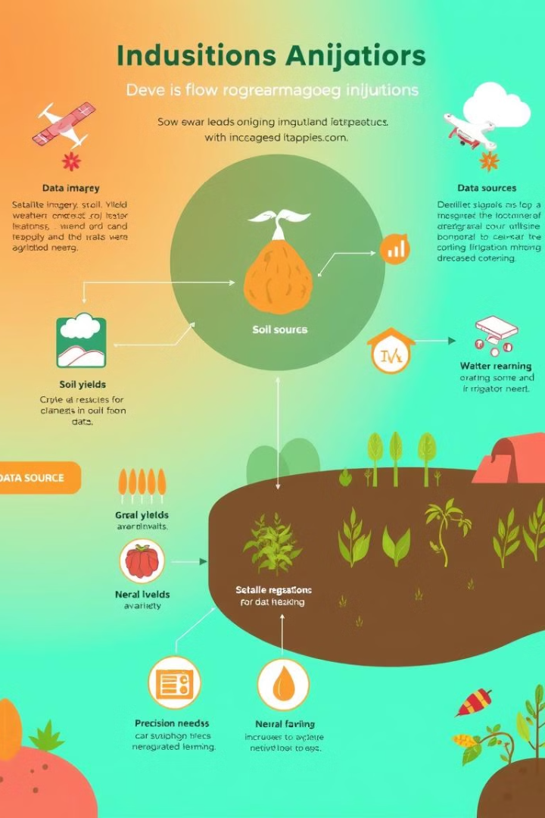
Abstract:
The Farming Assistance Web Service is a comprehensive digital platform designed to revolutionize agricultural practices through the integration of cutting-edge technologies such as IoT, machine learning, and geospatial analysis. It provides farmers with real-time insights into weather conditions, soil health, crop growth, pest management, and market trends, enabling them to make informed decisions that enhance productivity and sustainability. The service facilitates resource optimization by offering tailored recommendations for irrigation, fertilization, and crop selection based on localized data. Through its intuitive interface, the platform ensures accessibility for diverse users, including smallholder farmers. By promoting sustainable farming practices and improving operational efficiency, the service aims to address challenges in modern agriculture, support food security, and contribute to environmental conservation.

Slide 4
Introduction:
The Farming Assistance Web Service is a digital platform designed to support farmers in tackling modern agricultural challenges by integrating technology with traditional practices. It provides real-time insights into weather, soil health, crop growth, and market trends, empowering users to make informed decisions that optimize productivity and sustainability.
Leveraging IoT, machine learning, and geospatial tools, the service offers tailored recommendations for irrigation, fertilization, and pest management. With its user-friendly, mobile-accessible design, the platform ensures inclusivity for farmers in diverse regions, promoting sustainable farming and contributing to global food security.

Slide 5




Web Service Implementation: Architecture and Technology
Cloud Infrastructure
The service is hosted on a secure and scalable cloud platform, ensuring accessibility and reliability.
Data Storage
Data is stored securely in a cloud database, facilitating efficient retrieval and analysis.
Machine Learning
The service utilizes machine learning algorithms to analyze data and generate actionable recommendations.

Slide 6
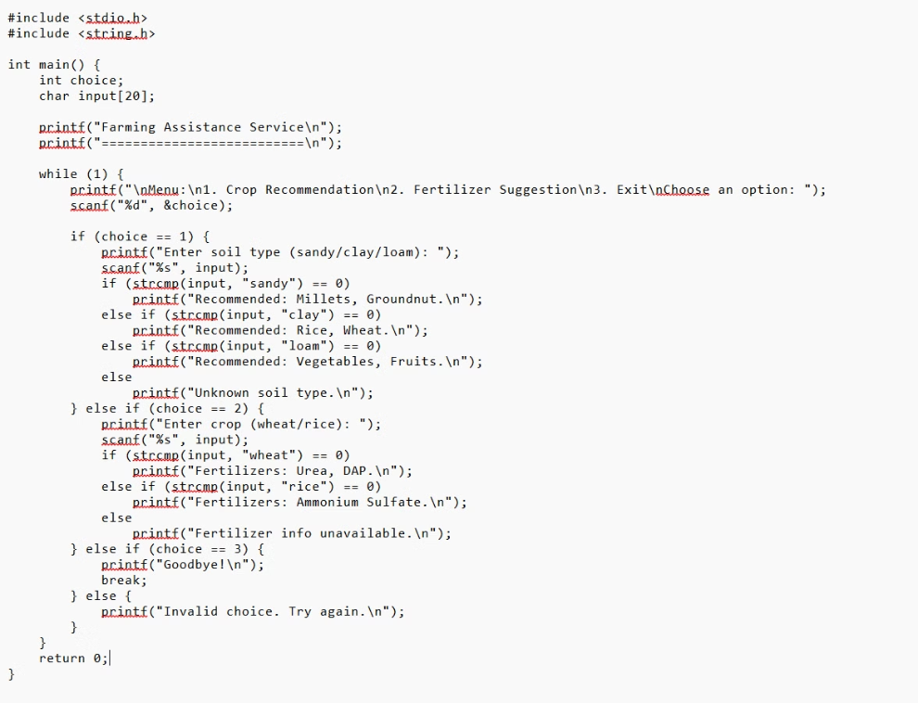
C Code Implemantation:

Slide 7
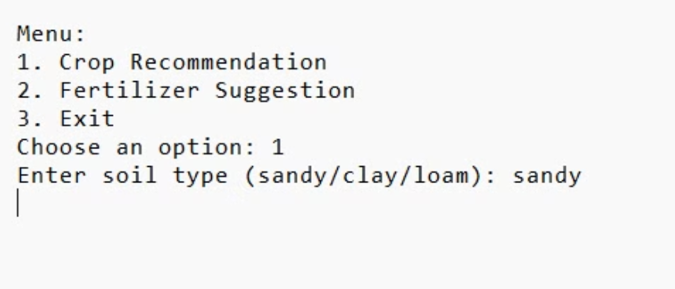

Example:
Input:
Output:

Slide 8
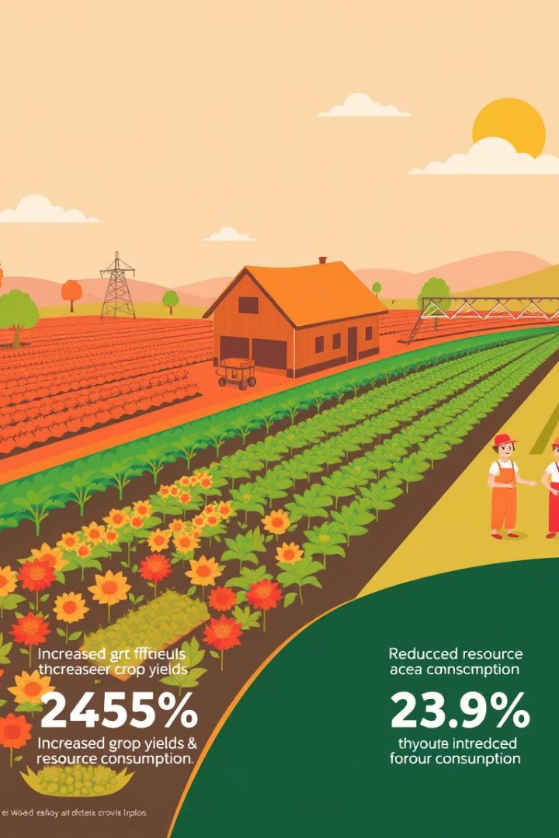
Results: Demonstrating the Impact
10%
5%
Yield Increase
Resource Savings
Farmers using the service have experienced significant yield increases on average.
The service helps farmers optimize resource usage, leading to cost savings.

Slide 9

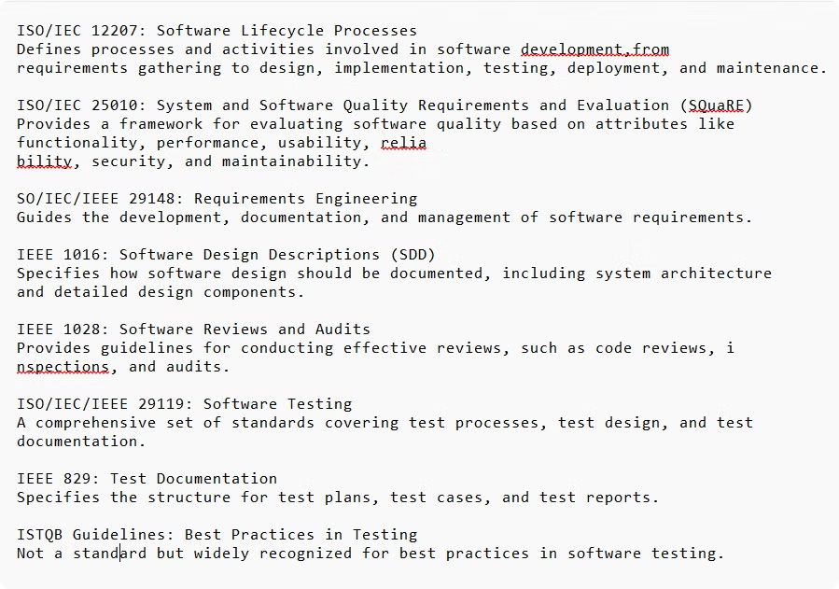
Engineering StandardsSystem Architecture
Security Standards
Data Standards
Frontend Standards
Backend Standards
IoT and Hardware Integration
Machine Learning Standards
Performance and Reliability
Documentation and Collaboration
Sustainability and Ethical Practices

Slide 10
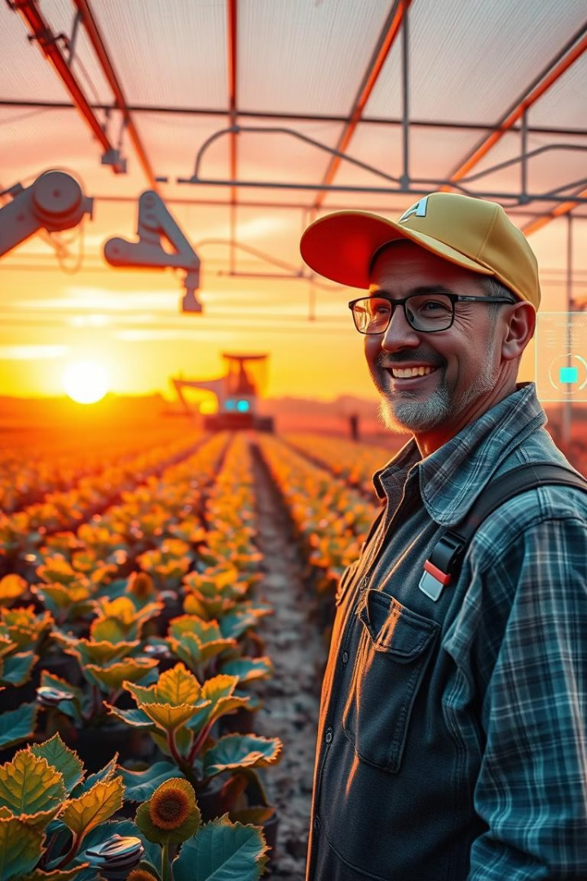



Future Scope: Expanding the Service
IoT Integration
The web service will be integrated with IoT devices to gather real-time data and improve accuracy.
New Data Sources
The service will incorporate data from satellite imagery, drones, and soil sensors to broaden its scope.
Personalized Insights
The service will continue to evolve and provide increasingly personalized insights for individual farmers.

Slide 11

Conclusion: A Powerful Tool for Modern Agriculture
The Farming Assistance Web Service is designed to address the pressing challenges faced by the agricultural industry by providing farmers with innovative, data-driven solutions to optimize their operations. Ultimately, this solution aims to transform traditional farming into a more efficient, sustainable, and resilient practice, contributing to the broader goals of food security and environmental conservation.Thank you for your time. The Farming Assistance Web Service represents a significant step towards a more sustainable and efficient future for agriculture

Slide 12

Thank You!
We appreciate your time and interest in the **Farming Assistance Web Service**. We believe this service holds the potential to revolutionize agriculture and make a positive impact on our world.

